Slide 1
WORLD OF DRONE
Drone Application: Surveillance

Slide 2
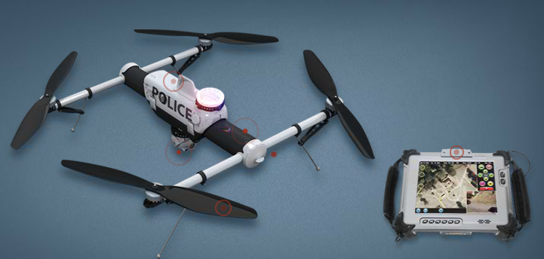
Drone Application: Surveillance
Aerial surveillance of large areas is possible with low-cost UAV.

Slide 3
Drone Application: Surveillance
Surveillance applications include livestock monitoring, wildfire mapping, pipeline security, home security, road patrol and antipiracy.

Slide 4
Drone Application: Surveillance
UAVs in commercial aerial surveillance is expanding with the advent of automated object detection.

